Slide 1

Corporate Equipment Allocation & Tracking
AUTOMATED ASSET MANAGEMENT SYSTEM | V1.0
Presented by: Naresh Nagula

Slide 2


The Challenge
Current Issues
Business Impact
•
Manual tracking leads to human error and data loss.
•
Increased operational costs due to lost assets.
•
Inefficient workflow for reception and maintenance teams.
•
Delays in equipment allocation impact employee productivity.
Difficulty in auditing and compliance.
•
•
Lack of visibility into inventory status and equipment condition.
•
No automated reminders for overdue returns.

Slide 3
Solution & Approach
A Microservices-Based Automated Platform

Slide 4










Proposed Solution
Automated Tracking
Smart Notifications
Streamlined digital logs for every allocation and return event, ensuring 100% accountability.
Real-time automated alerts for overdue items and maintenance requests via Kafka & Akka.
Role-Based Access
Real-time Inventory
Secure portals for Admin, Reception, Inventory, and Maintenance teams with specific privileges.
Instant visibility into asset availability, condition status, and user allocation history.

Slide 5
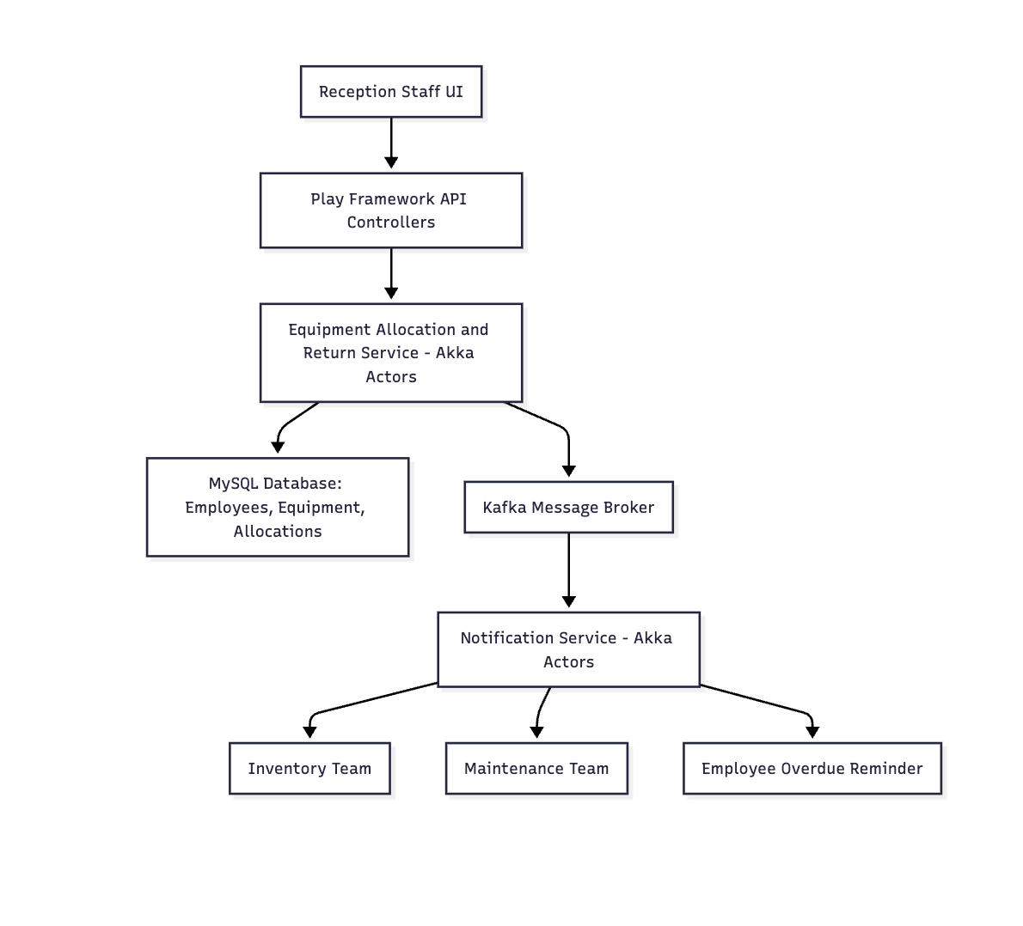

High-Level Architecture
Event-Driven Microservices Design

Slide 6
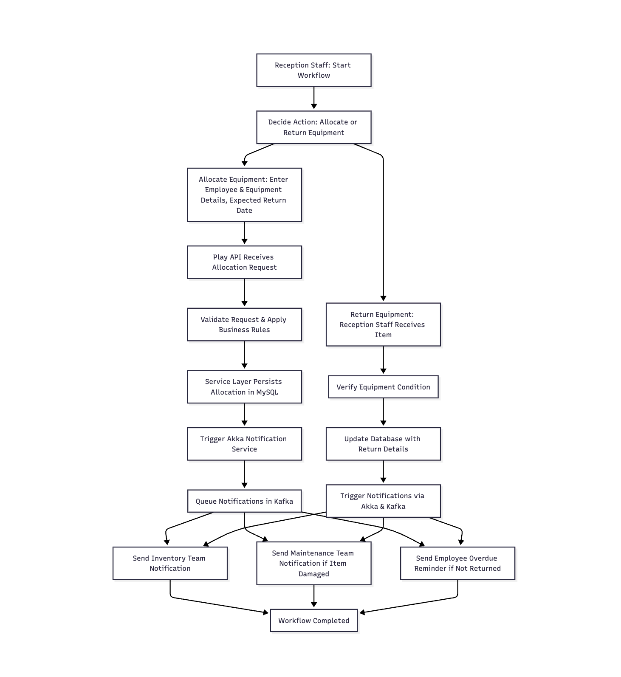

System Workflow
Operational Logic
1.
Request: Reception initiates allocation via Frontend.
2.
Validation: Play API validates user and equipment status.
3.
Processing: Service Layer updates MySQL Database.
4.
Event: Allocation event published to Kafka topic.
5.
Action: Akka Notification Service consumes event and triggers email/alert.

Slide 7
Microservices Strategy
Allocation Service
Notification Service
•
Built on Play Framework.
•
Powered by Akka Actors.
•
Handles REST API requests for CRUD operations.
•
Asynchronous message processing.
•
Consumes Kafka topics for reliable delivery.
•
Manages business logic for eligibility and availability.
•
Schedulers for periodic overdue reminders.
•
Direct interaction with MySQL Persistence layer.

Slide 8







Technology Implementation
Scala
Play
Akka
Kafka
Functional programming for robust, concise, and type-safe backend logic.
Reactive web framework for building scalable, non-blocking REST APIs.
Actor model for handling high-concurrency tasks and fault tolerance.
Distributed event streaming to decouple services and ensure data consistency.

Slide 9
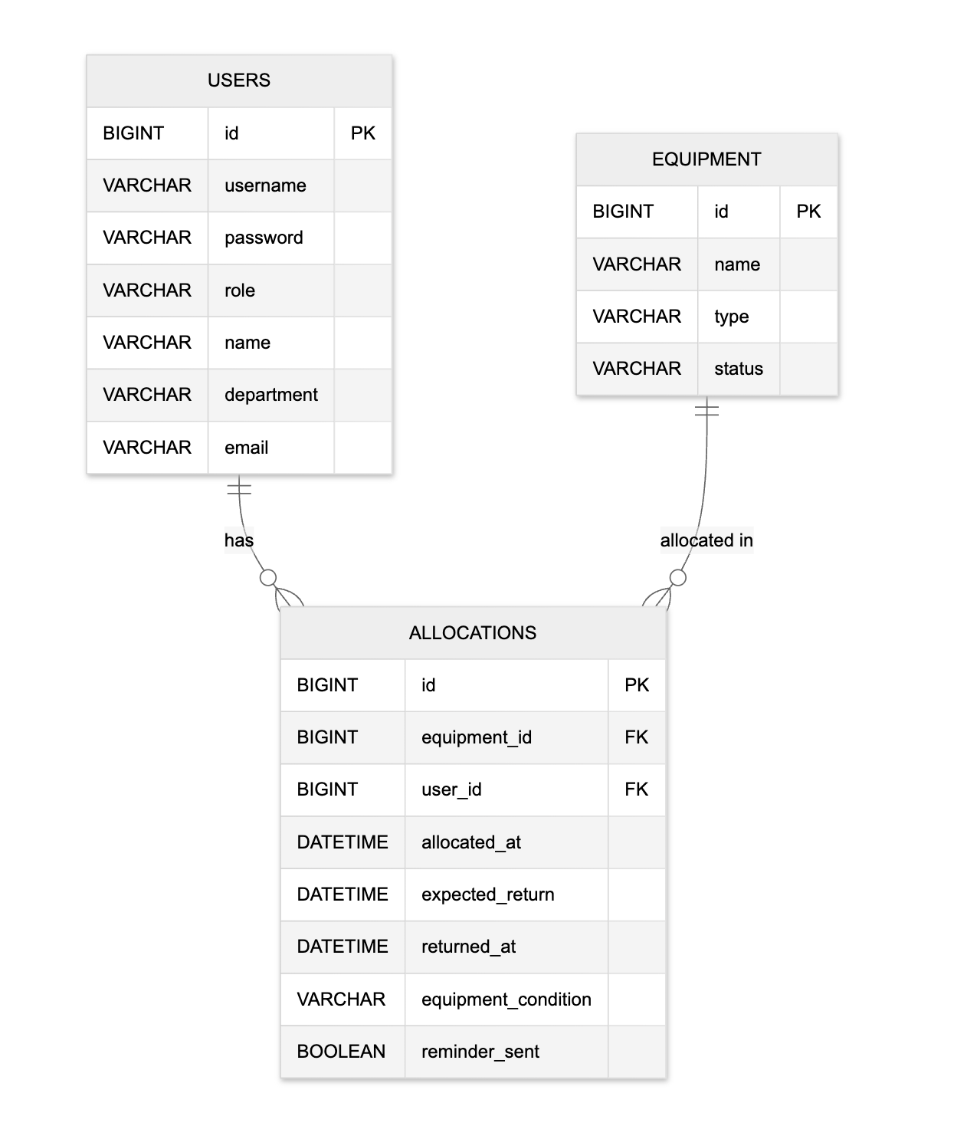

Database Schema
Core Entities
•
Users: Stores employee details, roles (Admin, Reception, etc.), and authentication credentials.
•
Equipment: Catalog of assets (Laptops, Projectors) with status (Available, Allocated, Damaged).
•
Allocations: Transactional table linking Users and Equipment, tracking dates and return conditions.

Slide 10
Security & Access Control
Authentication
Authorization
JWT (JSON Web Tokens) based stateless authentication ensures secure API access without server-side session storage.
RBAC (Role-Based Access Control) restricts endpoints:
•
Admin: Full System Control.
•
Reception: Allocate/Return.
•
Inventory: Read-only monitoring.
•
Maintenance: Repair status updates.

Slide 11
Thank You
CORPORATE EQUIPMENT ALLOCATION & TRACKING SYSTEM

